Slide 1
[ Data Preprocessing ]
Scaling
Normalization
Interpolation
Original Data
Preprocessed Data
Data 사이 통일되지 않은 value 값의 크기
일정하지 않은 time_stamp간격
Data 사이 통일된 value 값의 크기
일정한 time_stamp 간격

Slide 2
Preprocessed Data
Preprocessed
File
Repository
[ Data Preprocessing ]
Scaling
Normalization
Interpolation
FileIO.Save.binary_file( )
Original Data
Data 사이 통일된 value 값의 크기
일정한 time_stamp 간격
Data 사이 통일되지 않은 value 값의 크기
일정하지 않은 time_stamp간격

Slide 3
Original Data
[ Data Preprocessing ]
Scaling
Normalization
Interpolation
Preprocessed Data
Preprocessed
File
Repository
Data 사이 통일된 value 값의 크기
일정한 time_stamp 간격
FileIO.Save.
binary_file( )
Data 사이 통일되지 않은 value 값의 크기
일정하지 않은 time_stamp간격

Slide 4

Similarity Model
Preprocessed
File
Repository
Similarity.
Model.build( )
Save

Slide 5


Similarity Model
New data
Add new data
Similarity Report
Similarity report
Load / Save

Slide 6
Similarity Model
New data
Similarity Report
Add new data
Similarity report
Preprocessed
File
Repository
Similarity.
Model.build( )
Load / Save

Slide 7
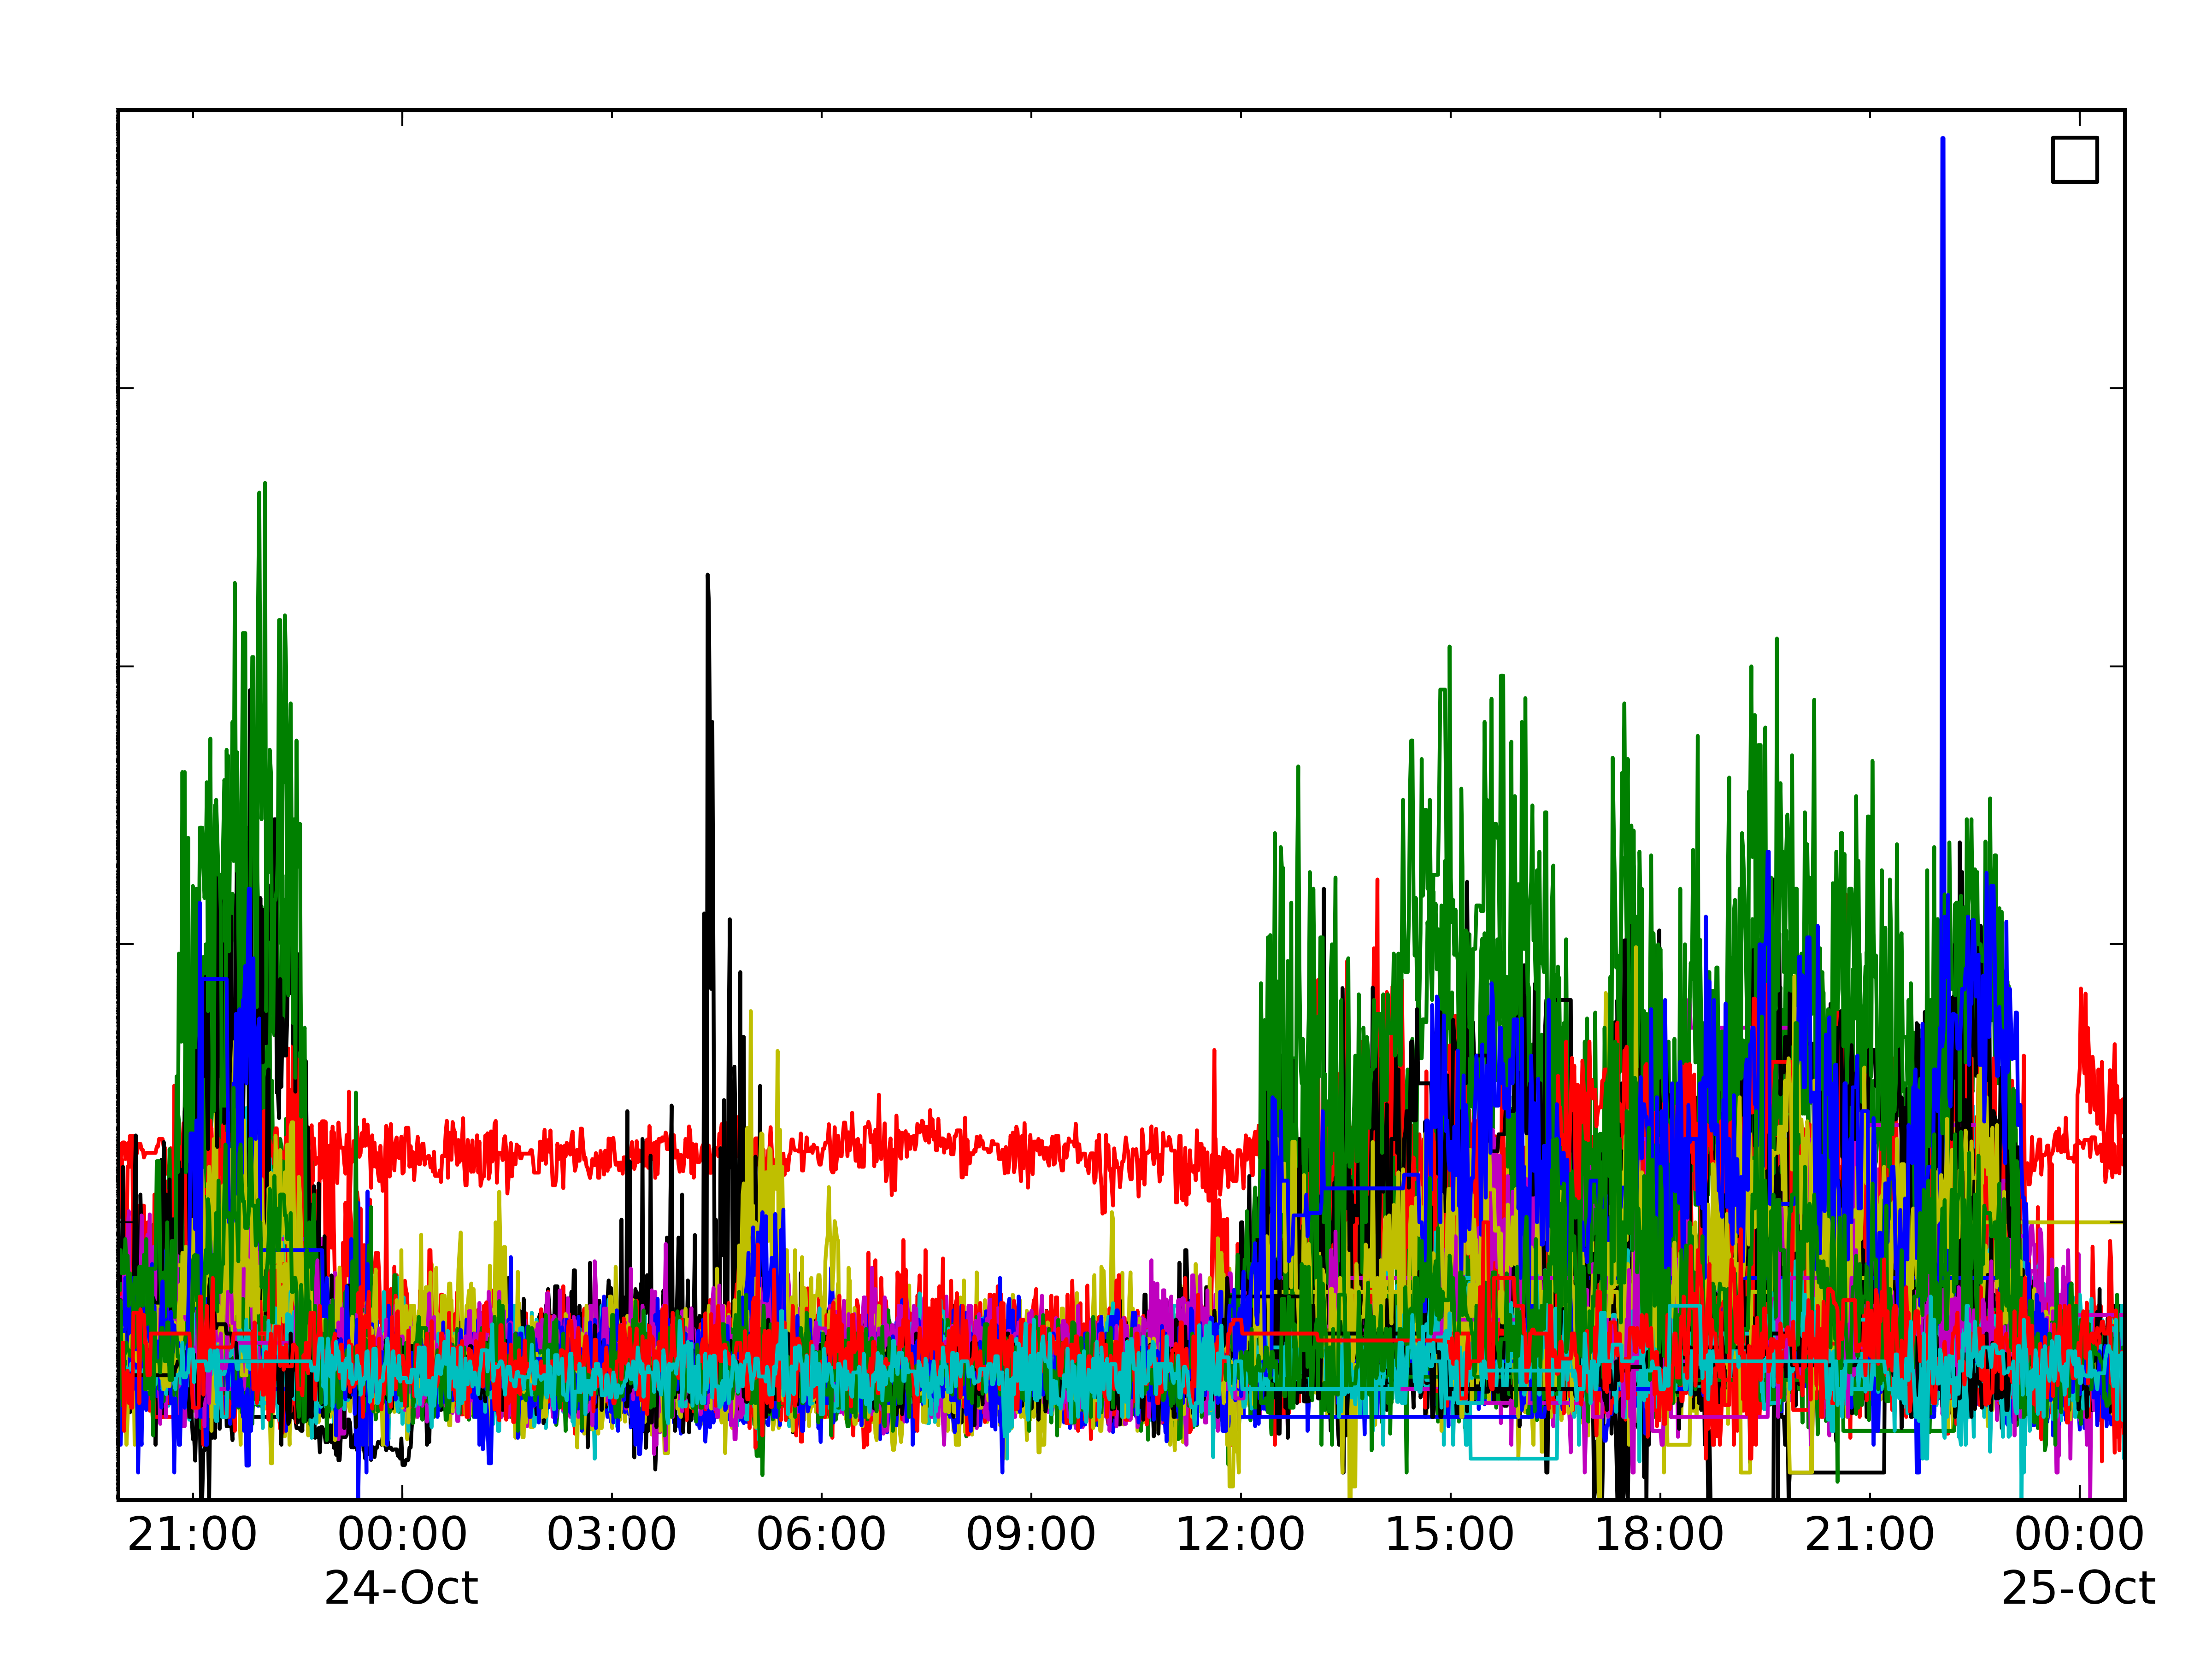
Data Base
sensors
improve
energy efficiency
analysis
Report
Data Model
abnormal
detection
dependency
grouping

Slide 8


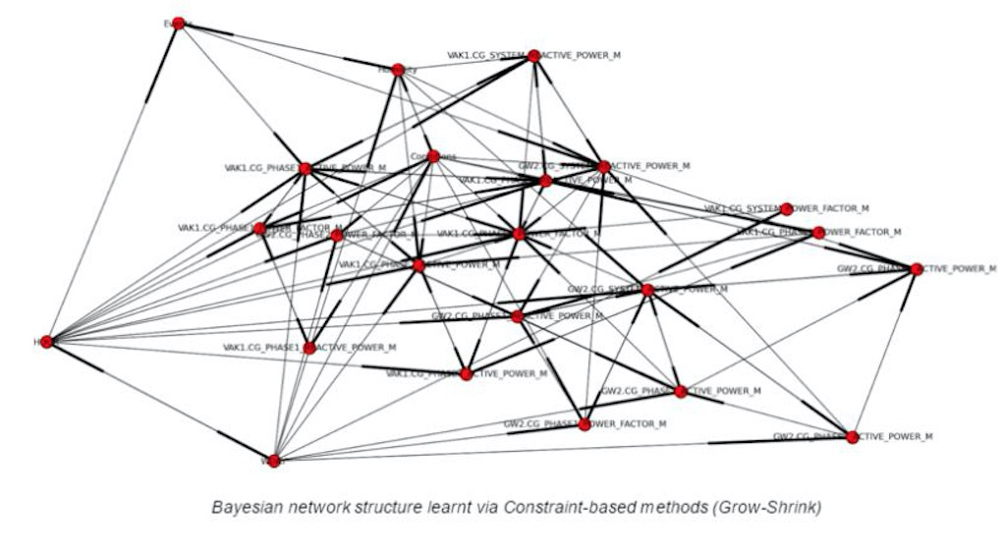
Similarity
Abnormal detection
Preprocessing
Covariance
Cosine similarity
Daily
Time scale
Interpolation
Euclidian distance
Manhattan distance
Weekly
Neighbor
Raw
sensor
data
Normalization
Gradient similarity
Reversed-gradient similarity
Monthly
Visualization
File name | Raw data | Refined data
A | (10mb) | (3mb)
B
C
Similarity models
A
B
C
…
A
B
Similarity score
…
…

Slide 9
Similarity
Abnormal detection
Preprocessing
Covariance
Cosine similarity
Daily
Time scale
Interpolation
Euclidian distance
Manhattan distance
Weekly
Neighbor
Raw
sensor
data
Normalization
Gradient similarity
Reversed-gradient similarity
Monthly
Visualization
File name | Raw data | Refined data
A | (10mb) | (3mb)
B
C
Similarity models
A
B
C
…
A
B
Similarity score
…
…

